Slide 1
My ‘Data Scientist’ Journey
Arfika Nurhudatiana
26 August, 2018
- Internal Use Only -

Slide 2






Hello!
I am Arfika
Used to be a full-time academic, now in academia & industry

Slide 3


My Journey So Far ….
IT Consultant
Postgraduate Student
Student
Scientist
2007
2007 – Dec 2009
2014
2016:
Postdoc
R&D
2014 - ...
(2016 on a break)
2017 - …
Lecturer
Lecturer & Practitioner
(‘Data Scientist’)

Slide 4
My three ‘data scientist’ roles
Student Researcher
Academic Researcher
Industry Researcher

Slide 5
Forensic Science
Biometric Applications
Commercial
Office
Smart Home
Entertainment Park
Laptop
Smart Phone
…
Government
e-KTP
Immigration
National defense
…
Forensic
CSI
Prison database
…

Slide 6
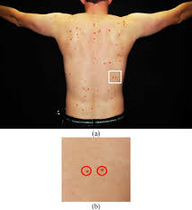
Forensic Science
Skin Marks

Slide 7
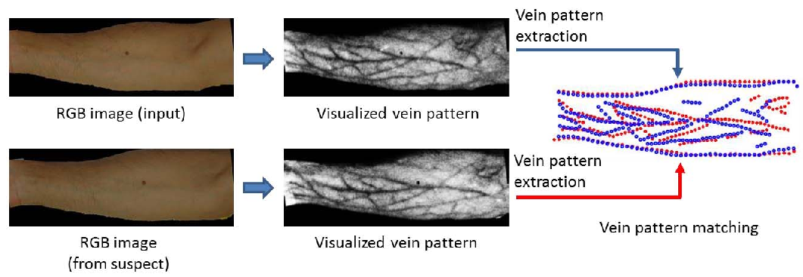
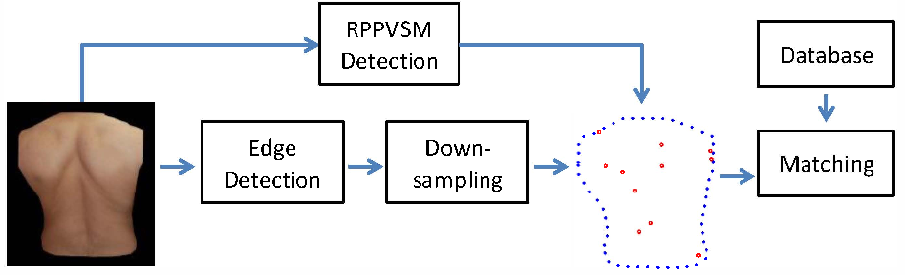
Forensic Science

Slide 8
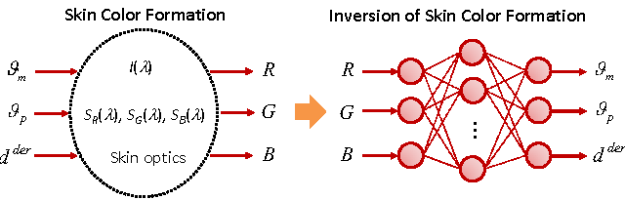
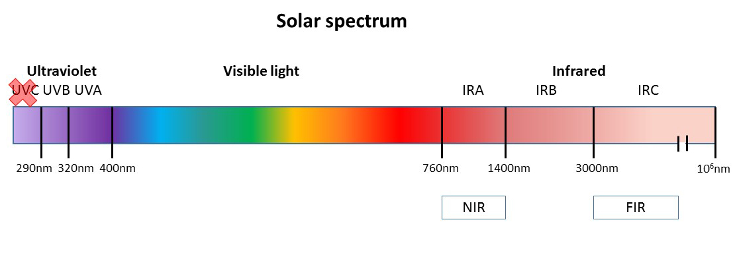
Forensic Science
How we see ‘skin’ is determined by:
Light reflectance (physics)
Camera filter (sensor)
Skin biochemistry (melanin, haemoglobin, betacarotene, depth of dermis (fat layer), etc.)

Slide 9
Some challenges if I want to continue working in the field ….
Not easy to get funding
Not a popular theme (low citation counts, takes a long time to be indexed on the Internet)
Not a ‘comfortable’ area of research
This made me shift to dermatology

Slide 10
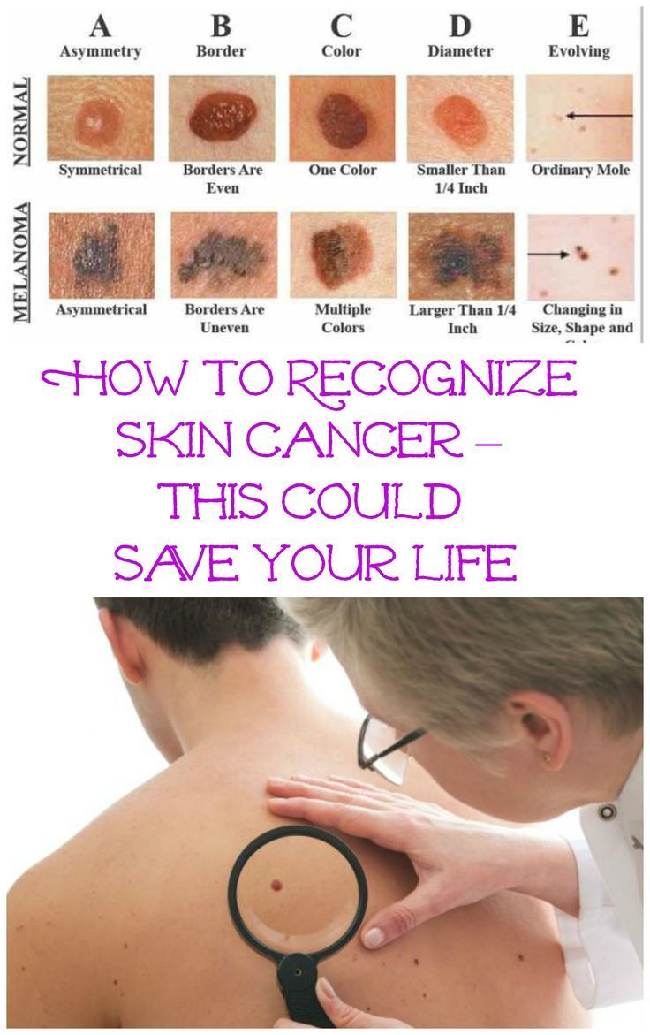
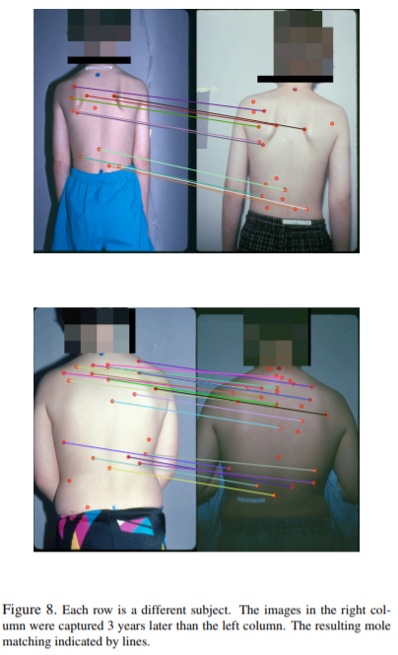
Dermatology
From http://www.cs.sfu.ca/~hamarneh/ecopy/cvpr2009.pdf

Slide 11
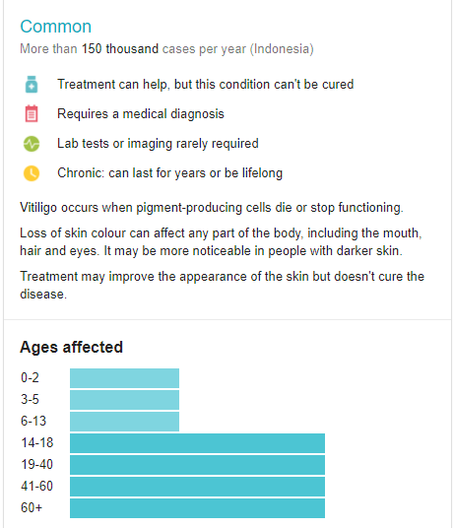
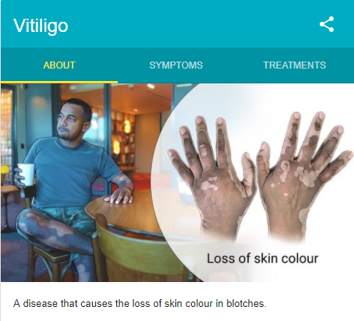
Dermatology

Slide 12
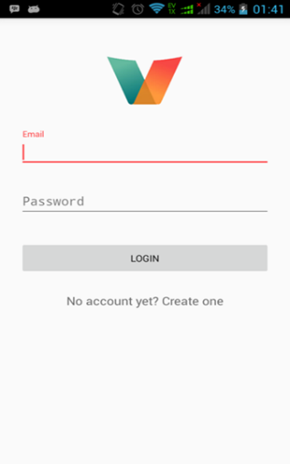
Main functionalities (prototype version):
User account creation and login
User profile management
Image capture and retrieval
Image analysis (skin segmentation and vitiligo depigmentation calculation)
Progress monitoring

Slide 15
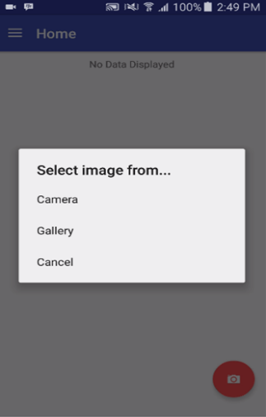
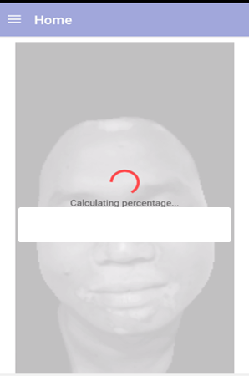
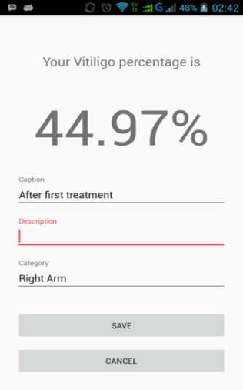

Slide 16
User Acceptance Testing (UAT) in a dermatology clinic in North Jakarta, Indonesia
Respondents: 3 volunteers
Rating:
1: strongly disagree
2: disagree
3: neutral
4: agree
5: strongly agree

Slide 17
Things that I realized along the way ….
Need to get access to REAL DATA (as a junior academic, it was hard to collect primary data). What seems to work on paper (90% accuracy) may not work in reality (30% accuracy with real noisy data).
Prototype IS NOT operationalizable system. Not even a Beta version. Need to think about performance issue, etc.
Need to get familiar with ‘tools’ and ‘approaches’ in industry (living 2 years in academia felt like missing 4 years of industry experience)
This made me take ‘sabbatical’ to learn from the industry and now here I am….

Slide 18
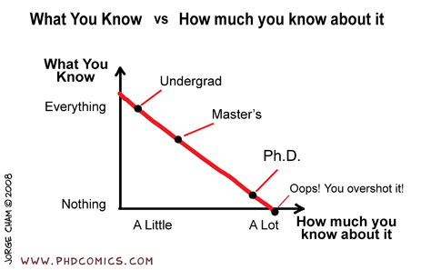

Slide 19
Thank you!

